Slide 1
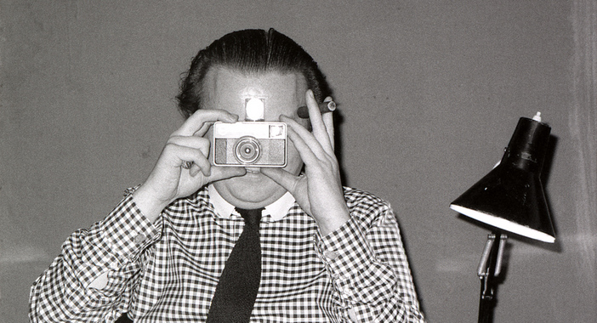

Grand Designs? Resilient patterns of regeneration
in the North of England
Daryl Martin

Slide 2
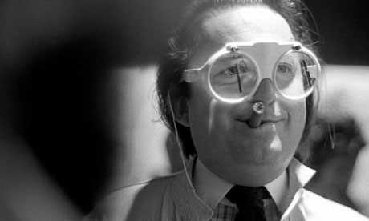
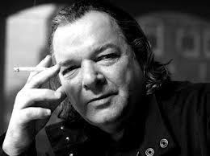
The regenerators

Slide 3
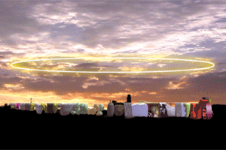
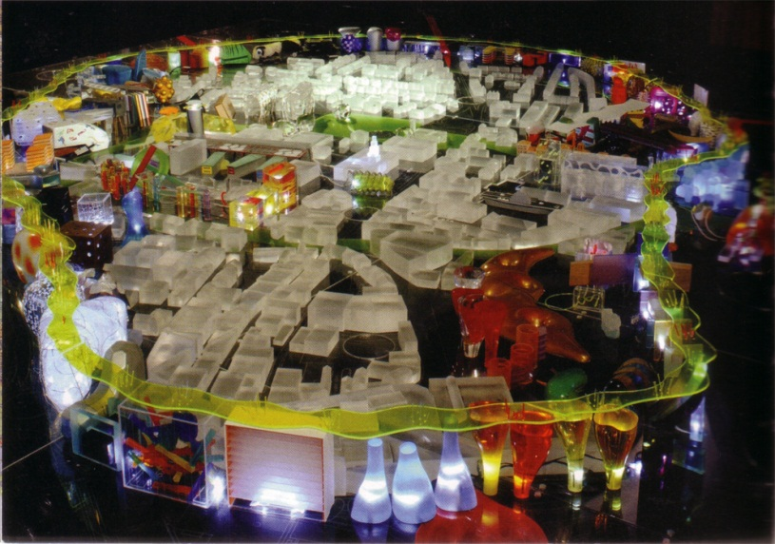
Alsop’s fables: Barnsley…

Slide 4
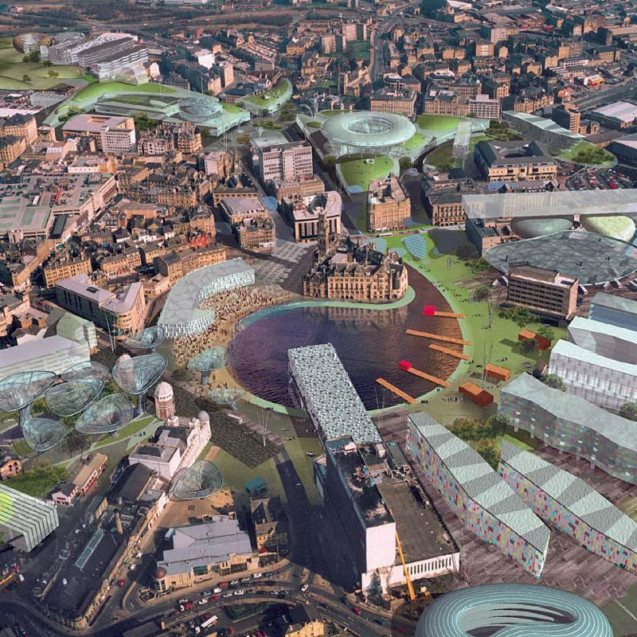
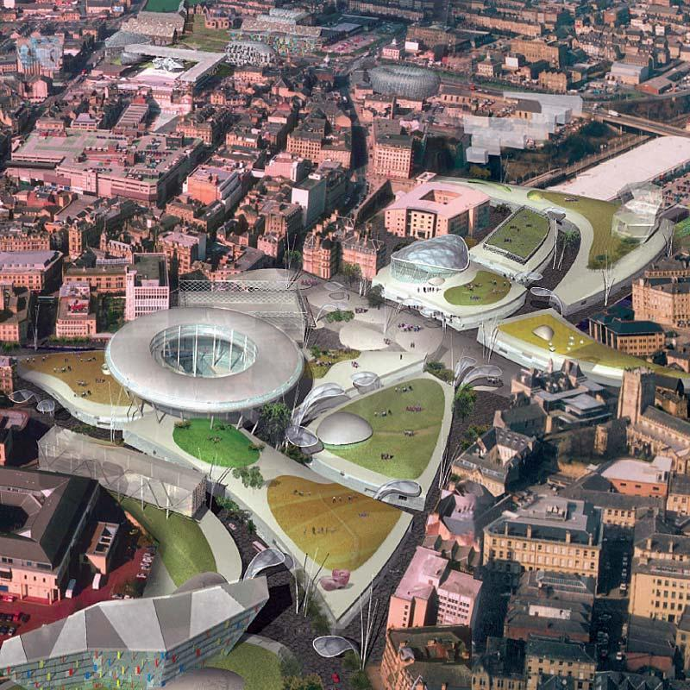
Bradford…

Slide 5
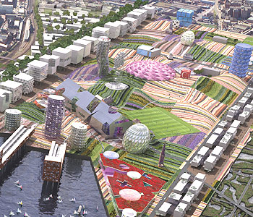
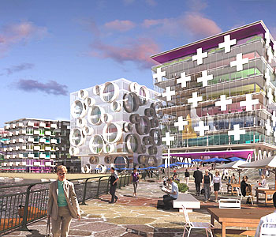
Middlesbrough…

Slide 6
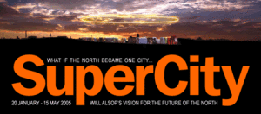
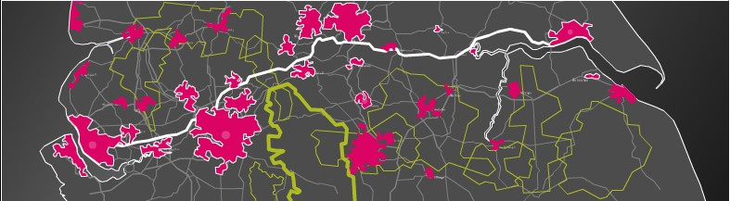
… and the M62

Slide 7
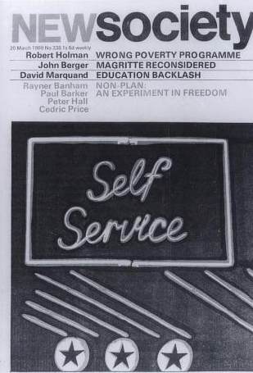
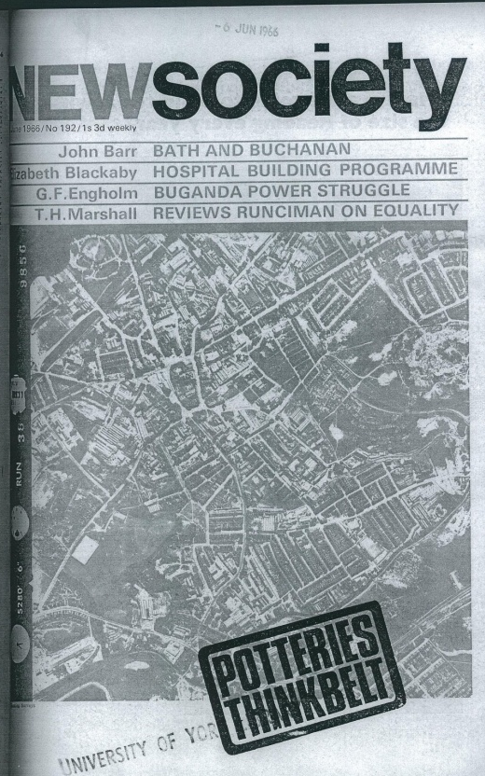
Price’s ideas for the New Society
Non-Plan (1969)
Potteries Thinkbelt (1966)

Slide 8
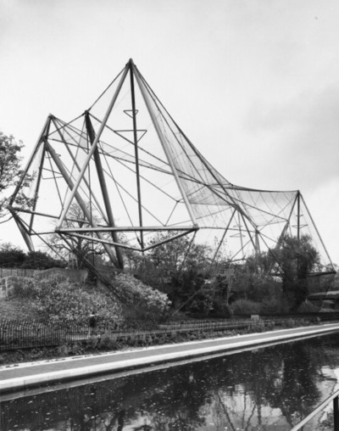
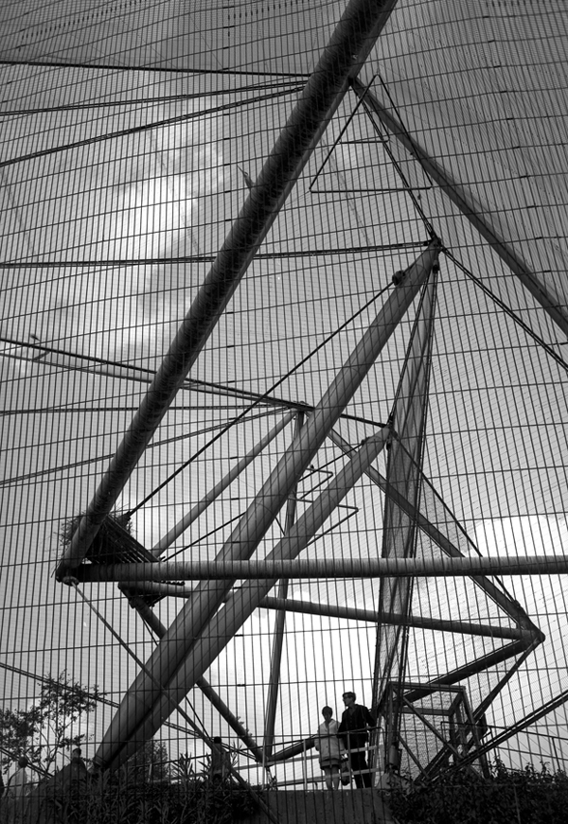
Projects still on the ground
Snowdon Aviary (1964)

Slide 9
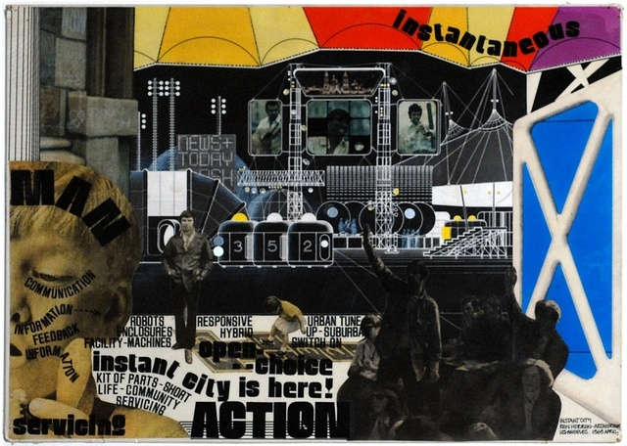
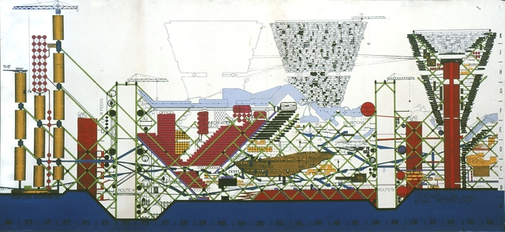
Archigram
Instant City (1968)
Plug In City (1964)

Slide 10
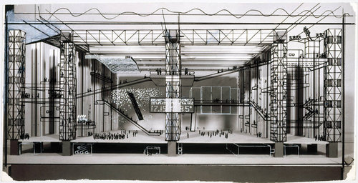
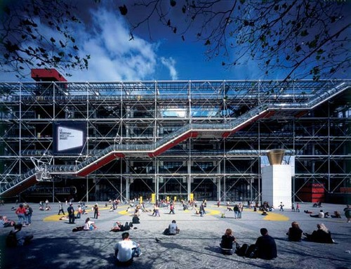
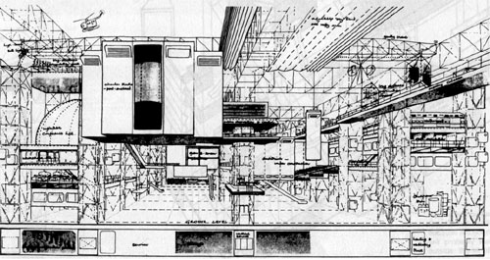
Price’s Unbuilt Projects
Fun Palace (1961)
Centre Georges Pompidou (1977)

Slide 11
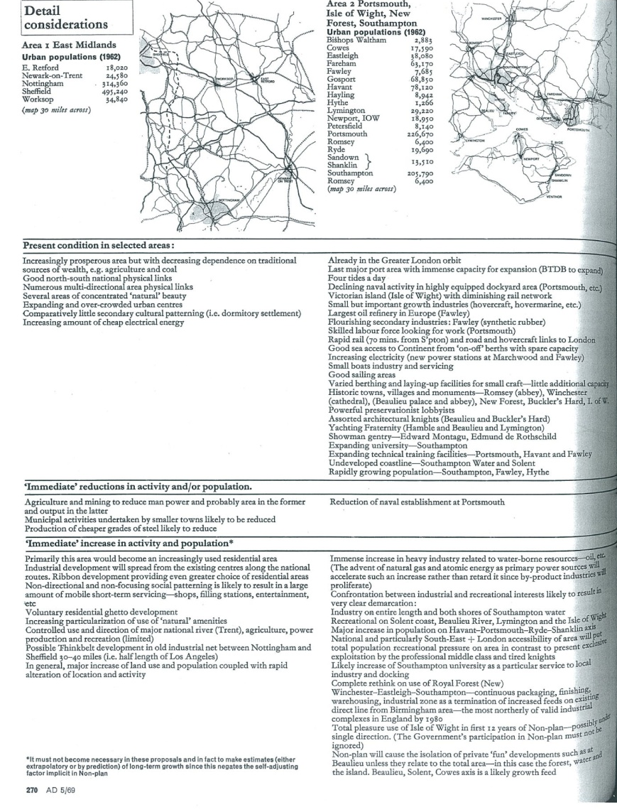
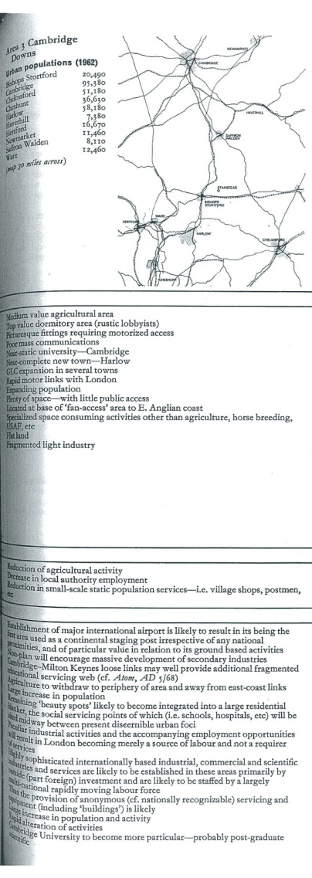
Lawrence Country, Montagu Country, Constable Country…

Slide 12
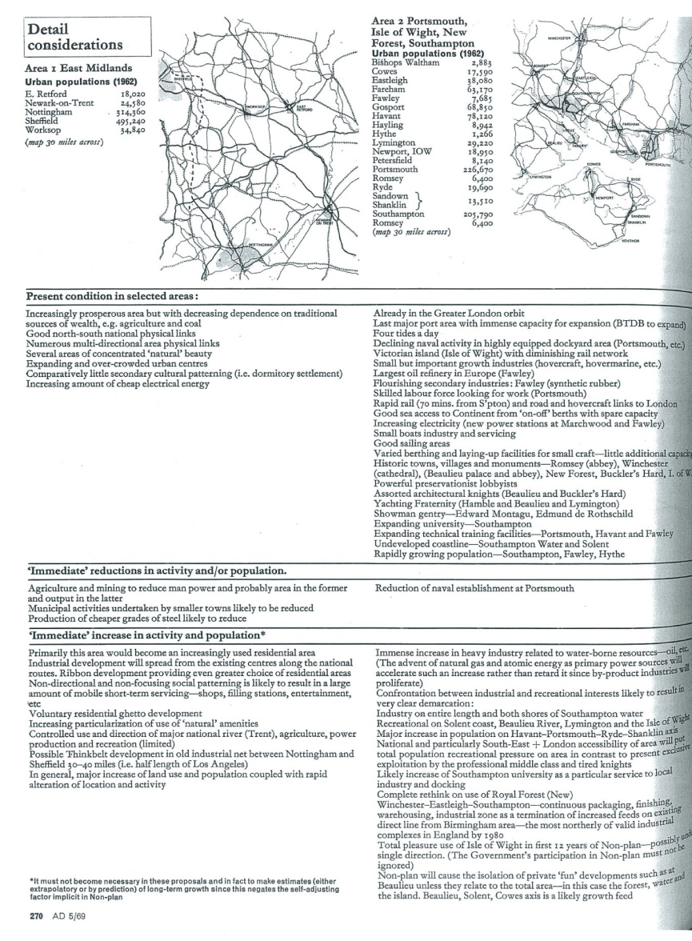
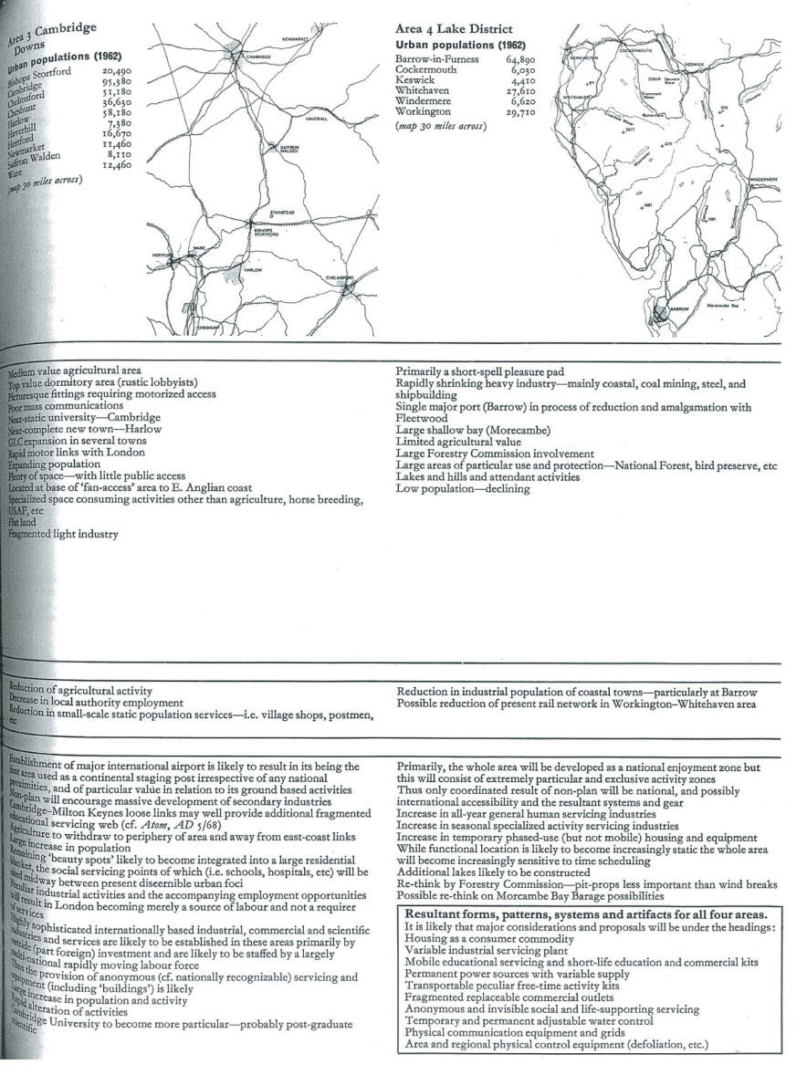
… and Wordsworth Country?

Slide 13
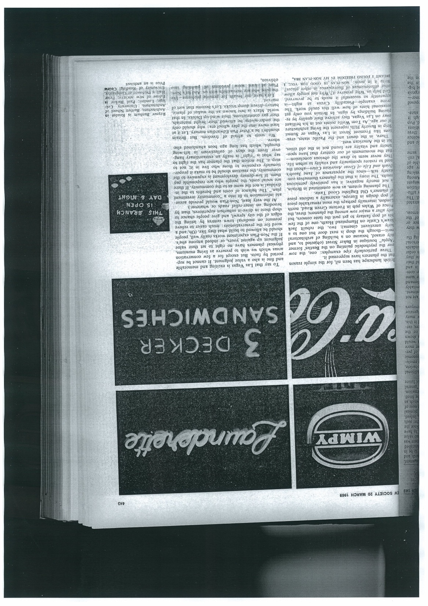
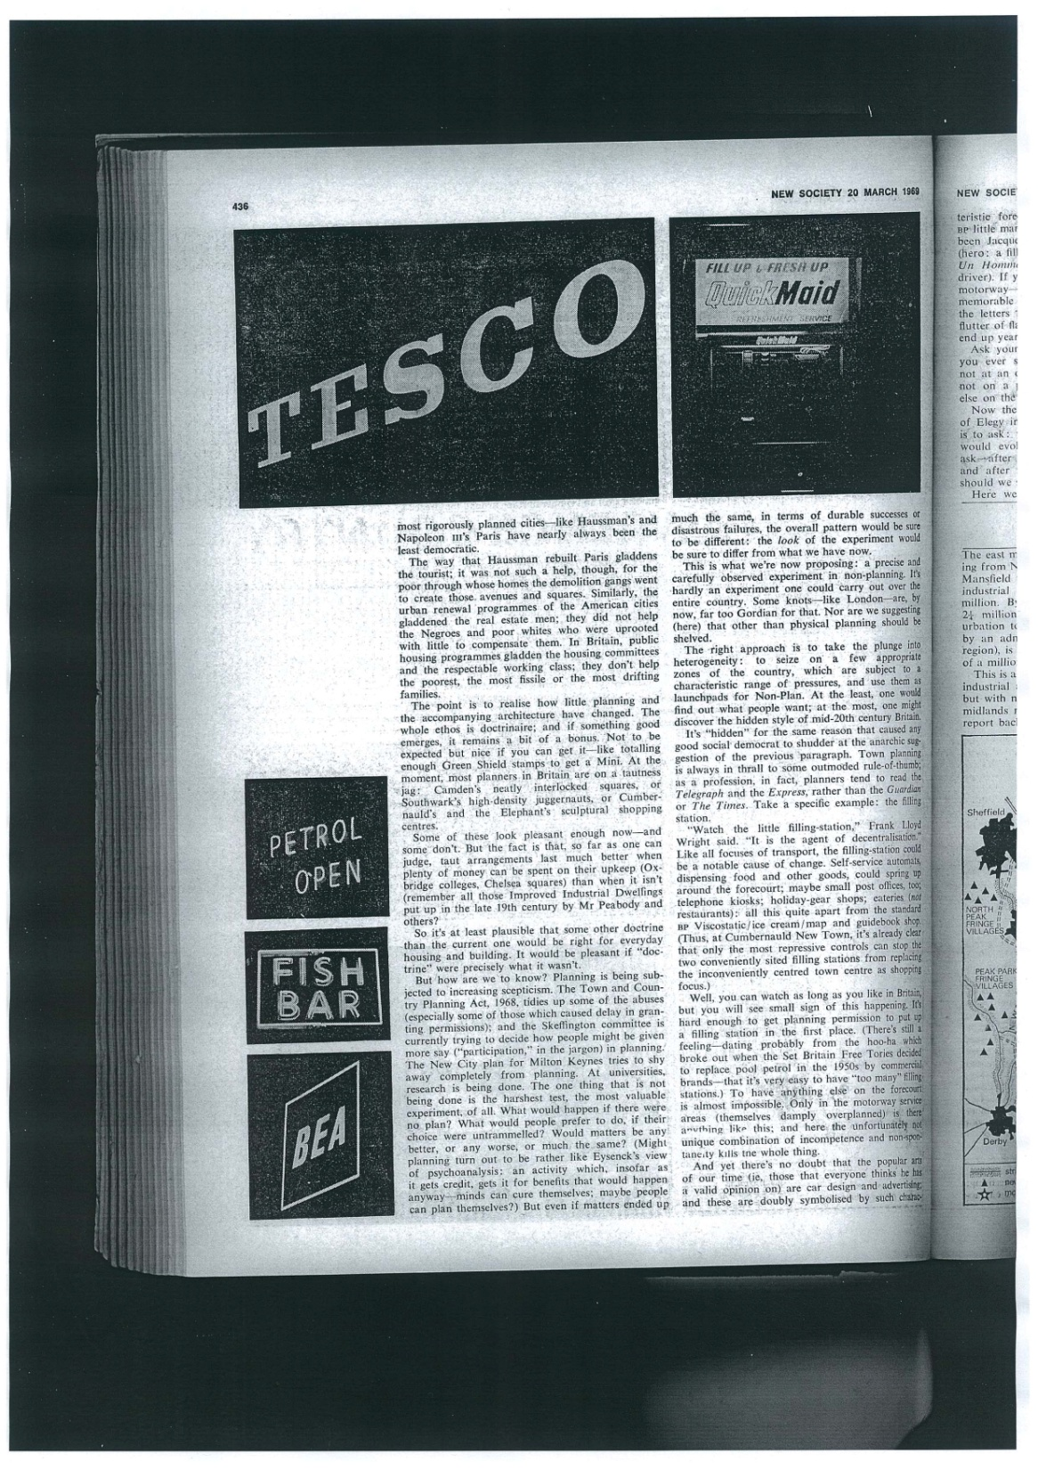
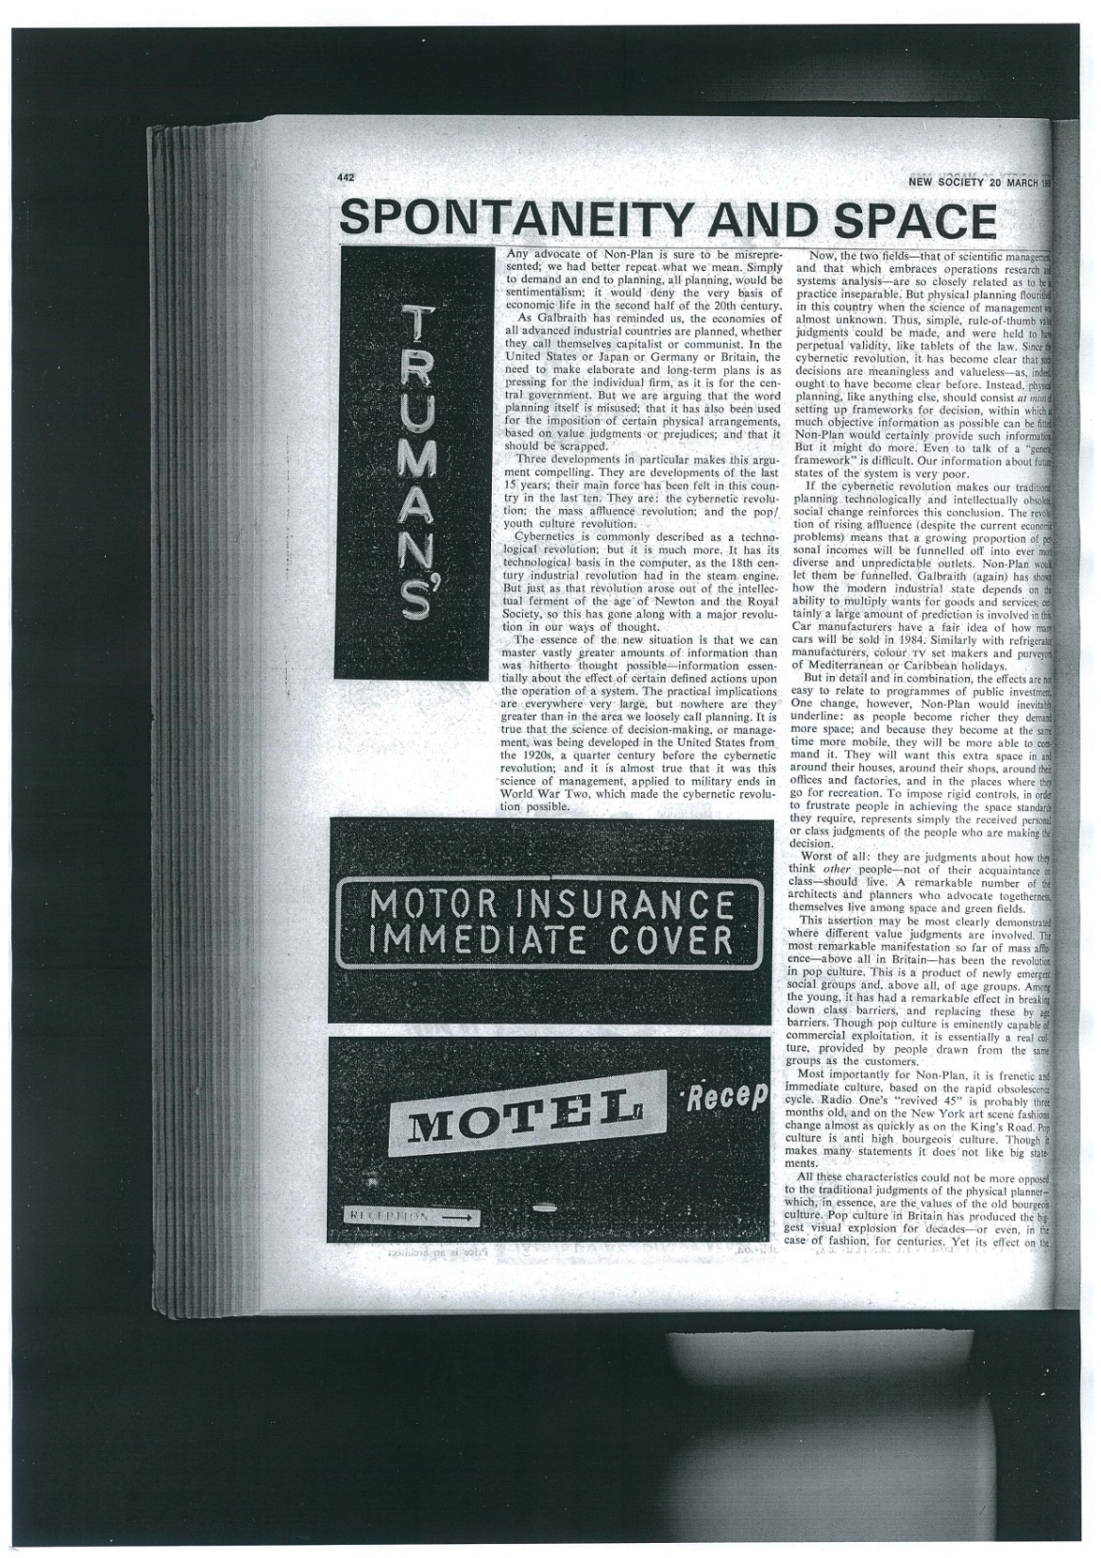


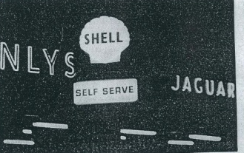
The Non-Plan Aesthetic

Slide 14
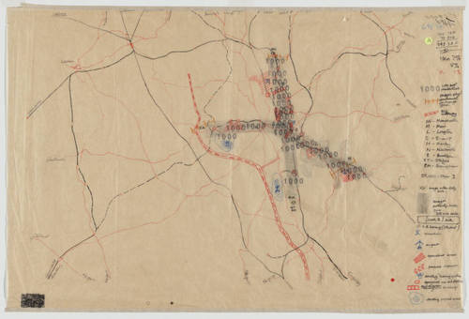
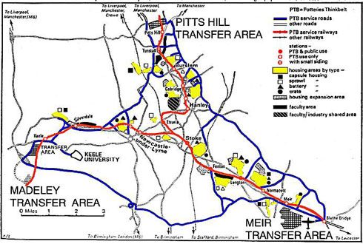
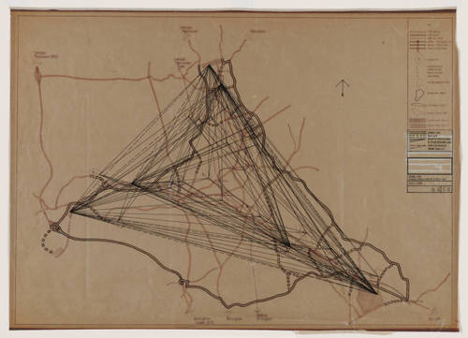
Potteries Thinkbelt

Slide 15
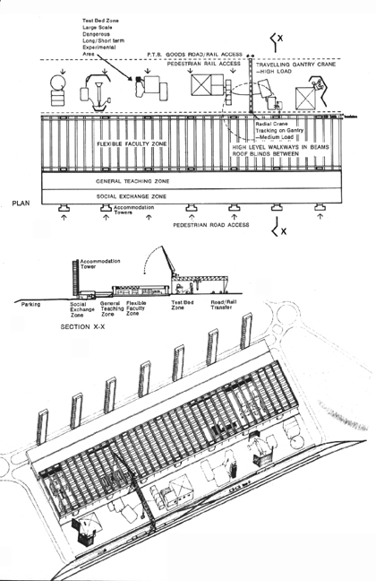
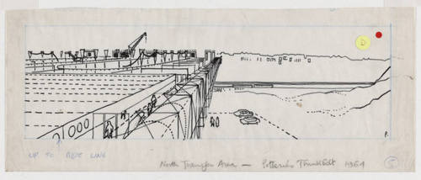
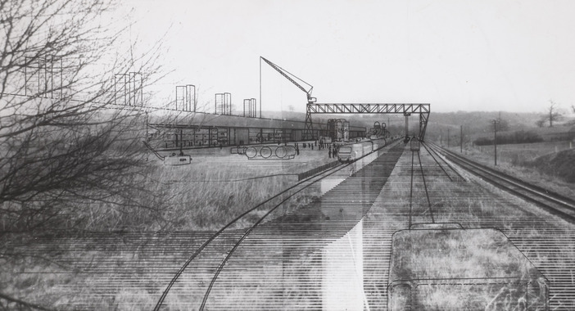
Transfer Areas: Faculty Bases

Slide 16
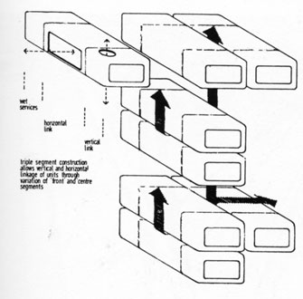
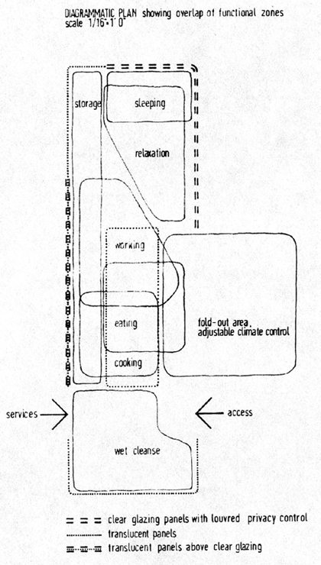
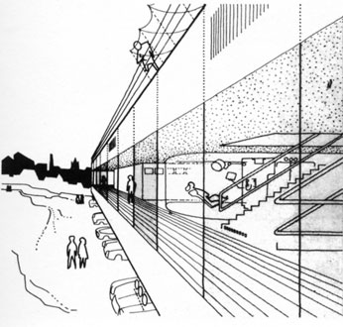
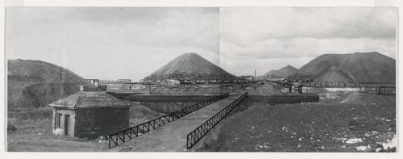
Housing: Battery, Capsule, Crate, Sprawl

Slide 17
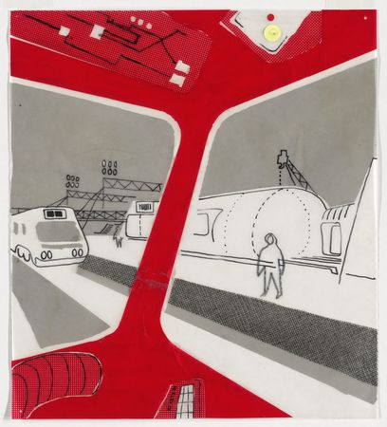
Universities and regeneration

Slide 18
Selected Bibliography
Barker, P. (1999) Non-Plan Revisited: or the real way cities grow. Journal of Design History, 12(2), pp.95-110.
Barker, P., et al. (1969) Non-Plan: an experiment in freedom. New Society, March 20, pp.435-443.
Hardingham, S. & Rattenbury, K. (2007) Supercrit 1: Potteries Thinkbelt. London: Routledge.
Hughes, J. & Sadler, S., ed. (2000) Non-Plan: essays on freedom, participation and change in modern architecture and urbanism. Oxford: Architectural Press.
Mathews, S. (2007) From Agit-Prop to Free Space: the architecture of Cedric Price. London: Black Dog.
Price, C. (2003) The Square Book. Chichester: Wiley-Academy.
Price, C. (1966) Potteries Thinkbelt. New Society, June 2, pp.14-17.

